Slide 1
Potential Security

Slide 2
1.Potential Security Violations
Unauthorized information release
Unauthorized information modification
Unauthorized denial of service

Slide 3
2.External vs Internal Security

Slide 4
3.Policies and mechanisms

Slide 5
Protection Vs Security
Protection is a mechanism and security is a policy.

Slide 6
Protection Domain

Slide 7
Design principles for Secure Systems
Economy
Complete Mediation
Open Design
Separation of Privileges
Least Privileges
Least Common Mechanism
Acceptability
Fail-Safe Defaults

Slide 8
THE ACCESS MATRIX MODEL
Most fundamental model of protection in computer sytems
First proposed by Lampson
Model consists of three components
Current Objects-finite set of entities to which access is to be controlled.The set is denoted by ‘O’.A typical example of an object is a file.
Current Subjects-Current subjects are a finite set of entities that access current objects.The set is denoted by ‘S’.A typical example of a subject is a process.Note that S is a subset of O.That is subject can be treated as objects.
Generic Rights-R={r1,r2,r3,……..rm} gives various access rights that subjects can have to objects.Eg:) Read,Write,Execute,own,delete.

Slide 9
An acess matrix representing a protection state
 | O1 | O2 | S1 | S2 | S3
S1 | read,write | Own,delete | own | sendmail | recmail
S2 | execute | copy | recmail | own | Block,wakeup
S3 | own | Read,write | sendmail | Block,wakeup | own

Slide 10
Implementation of the access matrix
Access matrix is likely to be sparse
Direct implementation of the access matrix for access control is likely to be very storage inefficient.
3 methods
*Capability Based Method
*Access control method
*Lock-Key Method

Slide 11
1.Capabilities
Corresponds to the row wise decomposition of the access matrix.
Each subject s is assigned a list of tuples(o,P[s,o]) for all objects o that is allowed to access.
The tuples are called capabilities.
If the subject s possesses a capability (o,P[s,o]) then it is authorized to access object o in manners specified in P[s,o].
Possesion of a capability by a user is treated as prima facie evidence that the user has authority to access the object in the ways specified in the capability.

Slide 12
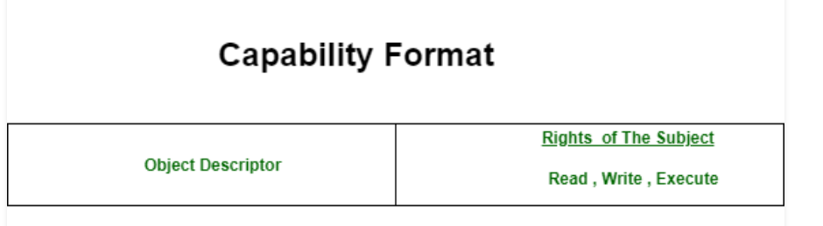
The list of capabilities assigned to subject s corresponds to access rights contained in the row for subject s in the access matrix.
The schematic view of a capability is shown below

Slide 13
Advantage of Capability based addressing
Provides address that is context independent(absolute address)
When a capability is used as an address mechanism,the system must allow the embedding of capabilities in user programs and data structures.

Slide 14
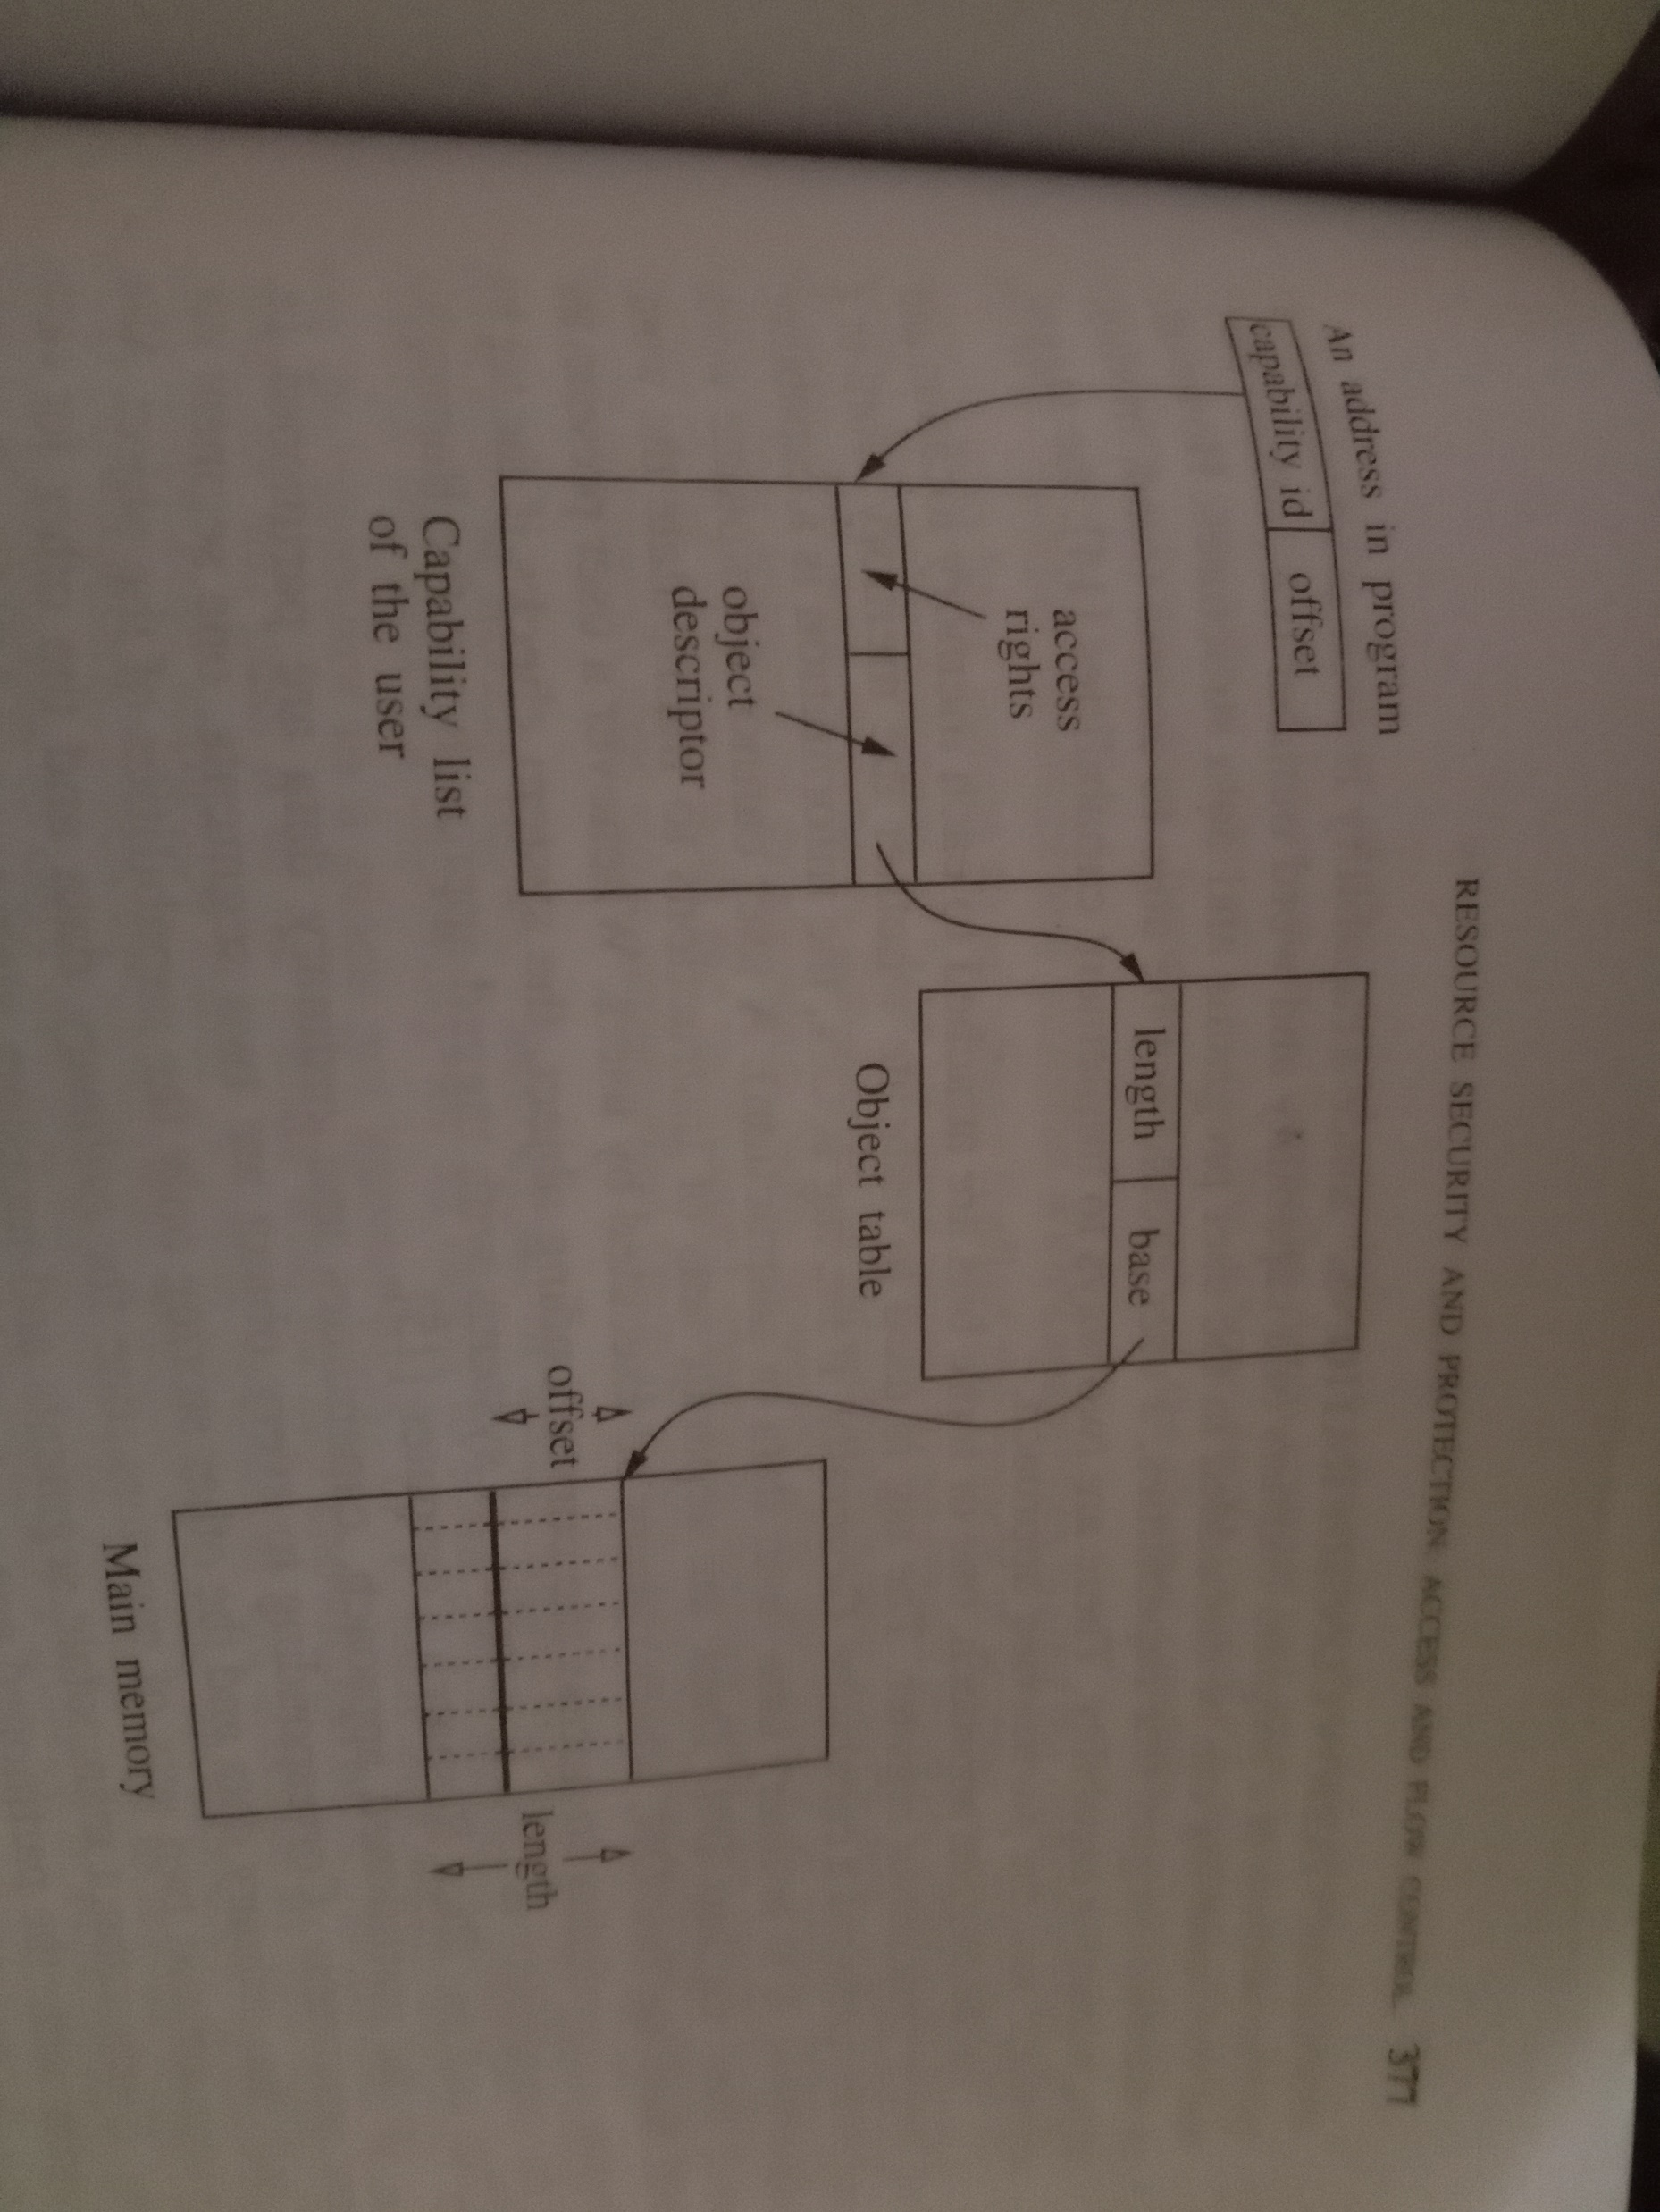
Capability Based Addressing

Slide 15
Capability id-checks access rights
Object descriptor-checks object table
TWO SALIENT FEATURES OF CAPABILITY BASED ADDRESSING
*Relocatability-an object can be relocated anywhere in the memory without making any change to the capabilities that refer to it.
*Sharing-Several programs can share the same object(pgm/data) with different names(object descriptors) for the object.

Slide 16
If there is a separate object table for each process or subject, then the resolution of an object descriptor is done in the context of a process.
If there is a global object table,then the resolution of an object descriptor is done in a single object context.

Slide 17
IMPLEMENTATION CONSIDERATIONS
Two ways to implement capabilities
a.The tagged approach
b.Partitioned approach

Slide 18
Main Advantages of capabilities
*Efficiency
*Simplicity
*Flexibility

Slide 19
Drawback of Capabilities
Control of propogation
Review
Revocation of access rights
Garbage Collection

Slide 20
2.The Access Control List Method
*corresponds to the column wise decomposition of the access matrix.
*Each object o is assigned a list of pairs(s,P[s,o]) for all subjects s that are allowed to access the object.
The access list assigned to object o corresponds to all access rights contained in the column for object o in the access matrix

Slide 21
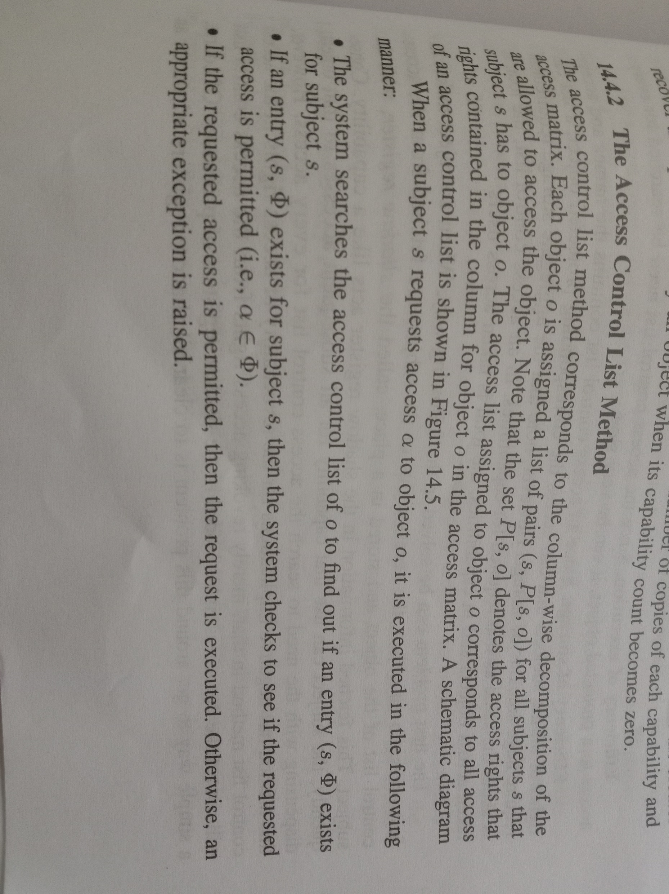

Slide 22
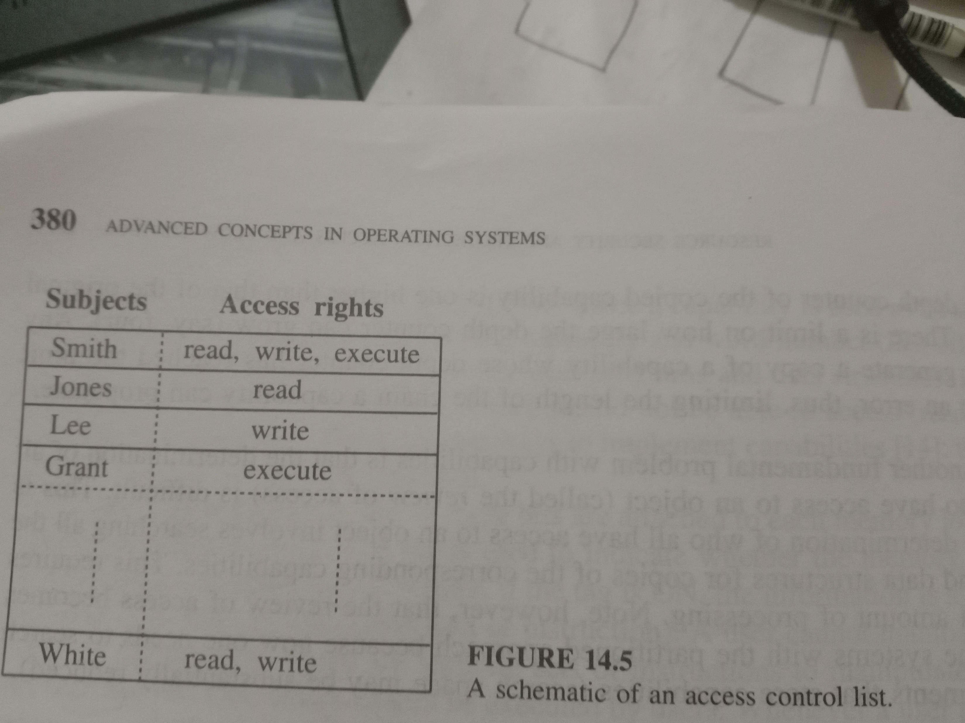

Slide 23
MAJOR FEATURES OF ACCESS CONTROL LIST
Easy Revocation
Easy Review of an access

Slide 24
2 Main issues in implementation considerations
1.Efficiency of execution
Can be solved by using shadow register.
2.Efficiency of Storage
Can be solved by using protection register

Slide 25
Protection groups
Concept was introduced to reduce the overhead of storing lengthy access control lists.
Subjects are divided into protection groups and the access control list consists of the names of groups along with their access rights.
Thus the number of entries in an access control list is limited by the number of protection groups, and therefore high efficiency is achieved.

Slide 26
Authority to change an access control list
Provides two ways to control propogation of access rights.
Self Control and Hierarchial Control

